Slide 1

Data Visualisations REG COVID Project collaborations

Slide 2
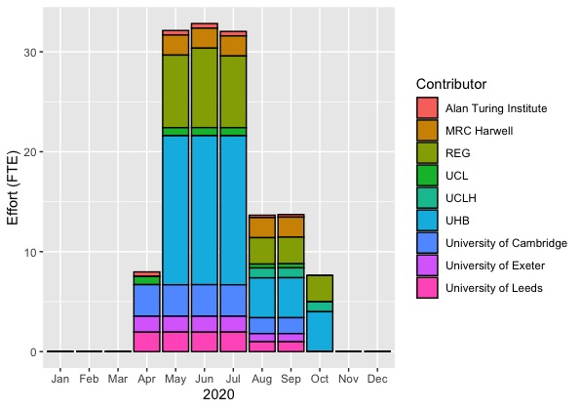
Partner effort by month - stacked
Conclusions from the data visualisation:
Since August, the total amount of effort being provided from all partners has reduced by over half.
August and September provided effort from the greatest number of partners, with UCLH starting to provide effort from August onwards.
October required the least amount of effort from partners with only UHB, UCLH and REG providing effort.
To date, UHB has provided the greatest amount of effort for collaboration on Covid projects, with REG providing the second greatest amount
Delivery partner

Slide 3
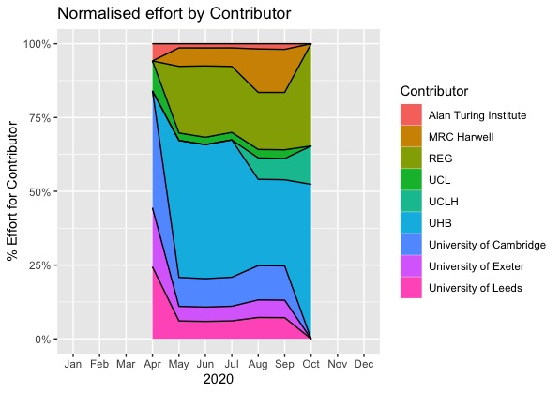
% Partner effort - normalised
Delivery partner

Slide 4
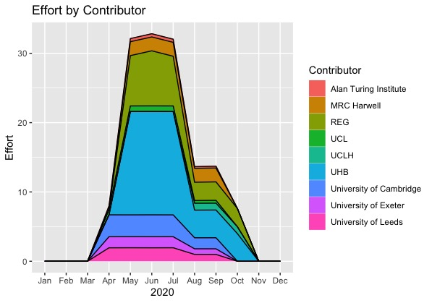
Partner effort – stacked
Delivery partner

Slide 5
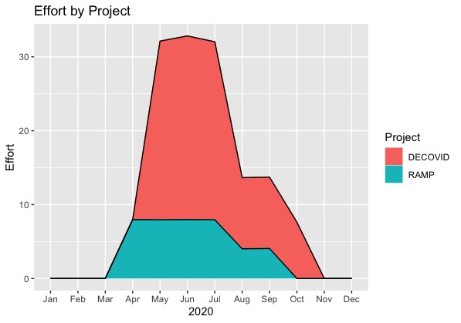
Project effort - stacked

Slide 6
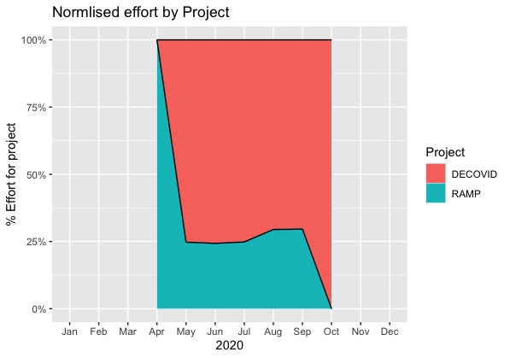
Project effort -normalised

Slide 7
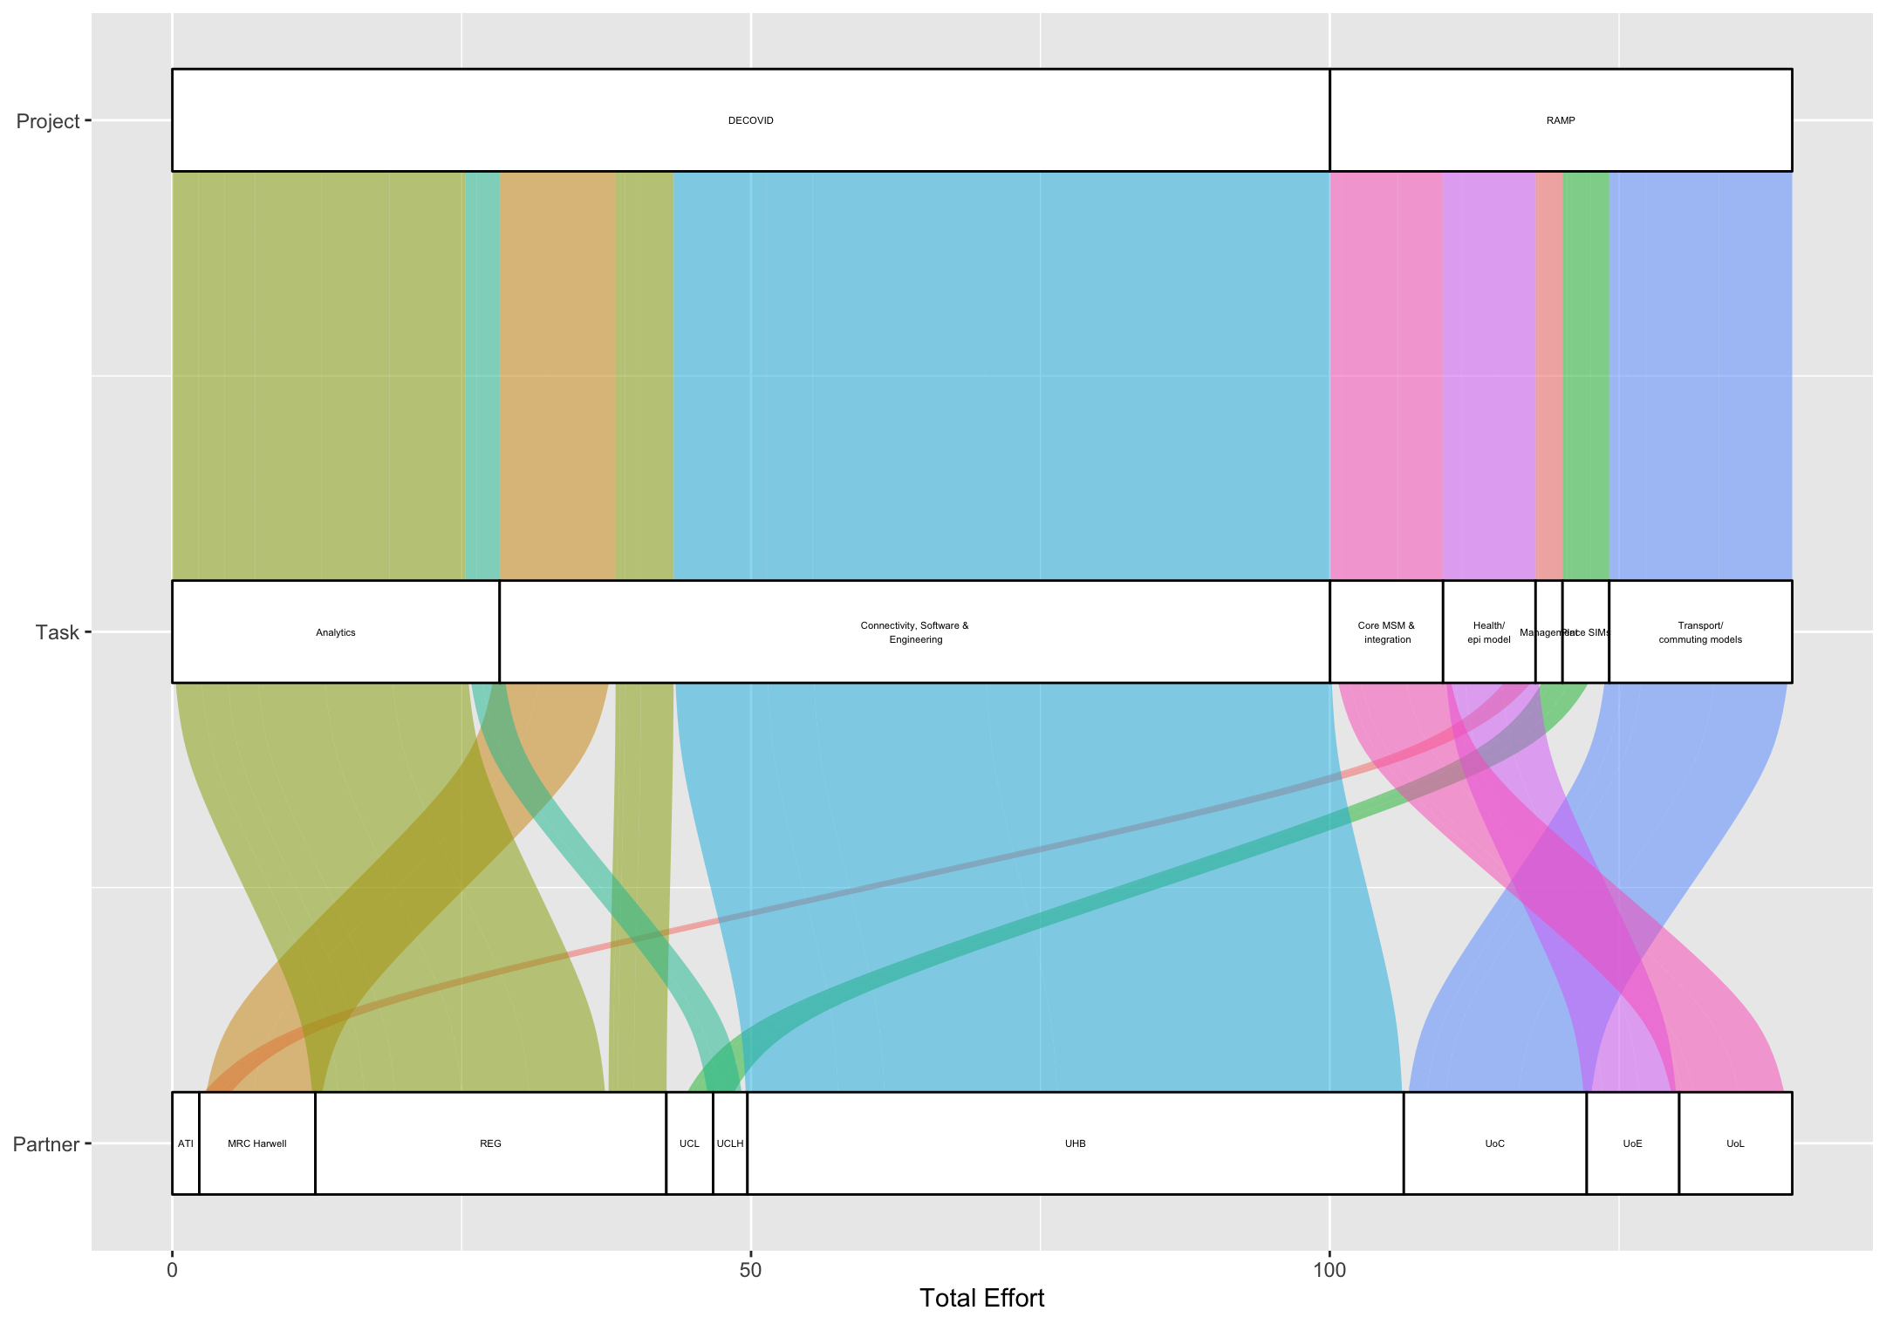
Project: Task: Partner - alluvial
Conclusions extracted from the alluvial graph:
DECOVID
RAMP
Core MSM & Integration
Health/ EPI Model
Management
Place SIMs
Transport/ Commuting Models
Analytics
Connectivity, Software & Engineering
Partners
ATI: The Alan Turing Institute
MRC Harwell
REG: Research Engineering Group (ATI)
UCL: University College London
UCLH: University College London Hospitals
UHB: University Hospitals Birmingham
UoC: University of Cambridge
UoE: University of Exeter
UoL: University of Liverpool
MRC Harwell
REG
UHB
UoC
UoE
UoL
ATI
UCL
UCLH

Slide 8
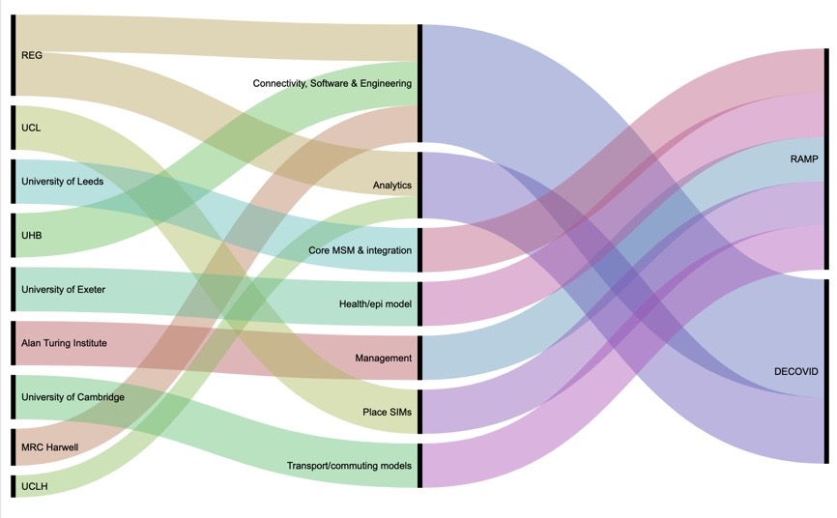
Project: Task: Partner - alluvial
Conclusions extracted from the alluvial graph:

Slide 9
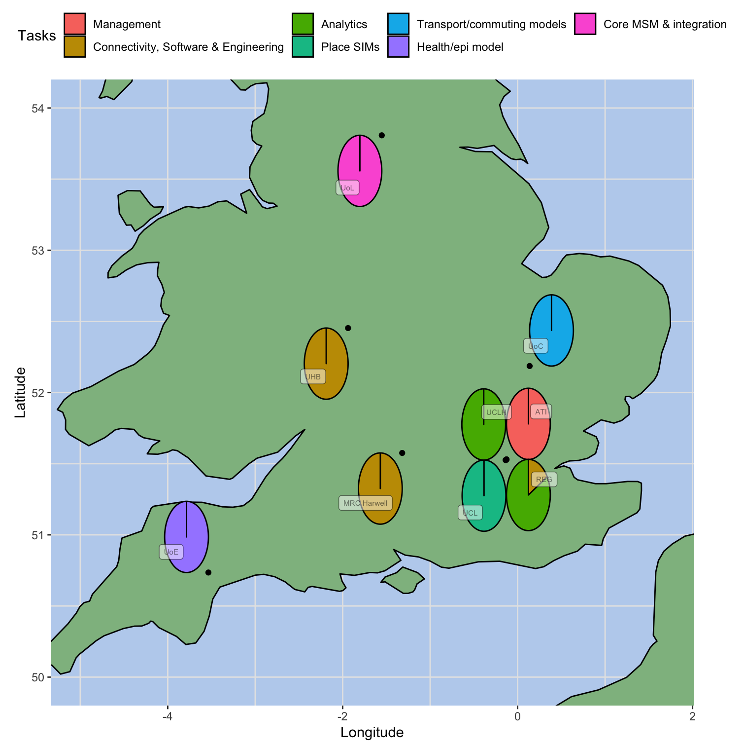
Task involvement by partners across Covid projects

